Slide 1

EEG Signal Classification using transfer learning
Mohammad Mahdi Mirrashid
Mohammad Bagher Shamsollahi
mohammadmahdi.mirrashid@ee.sharif.edu
EE Department – Sharif University of Technology

Slide 2
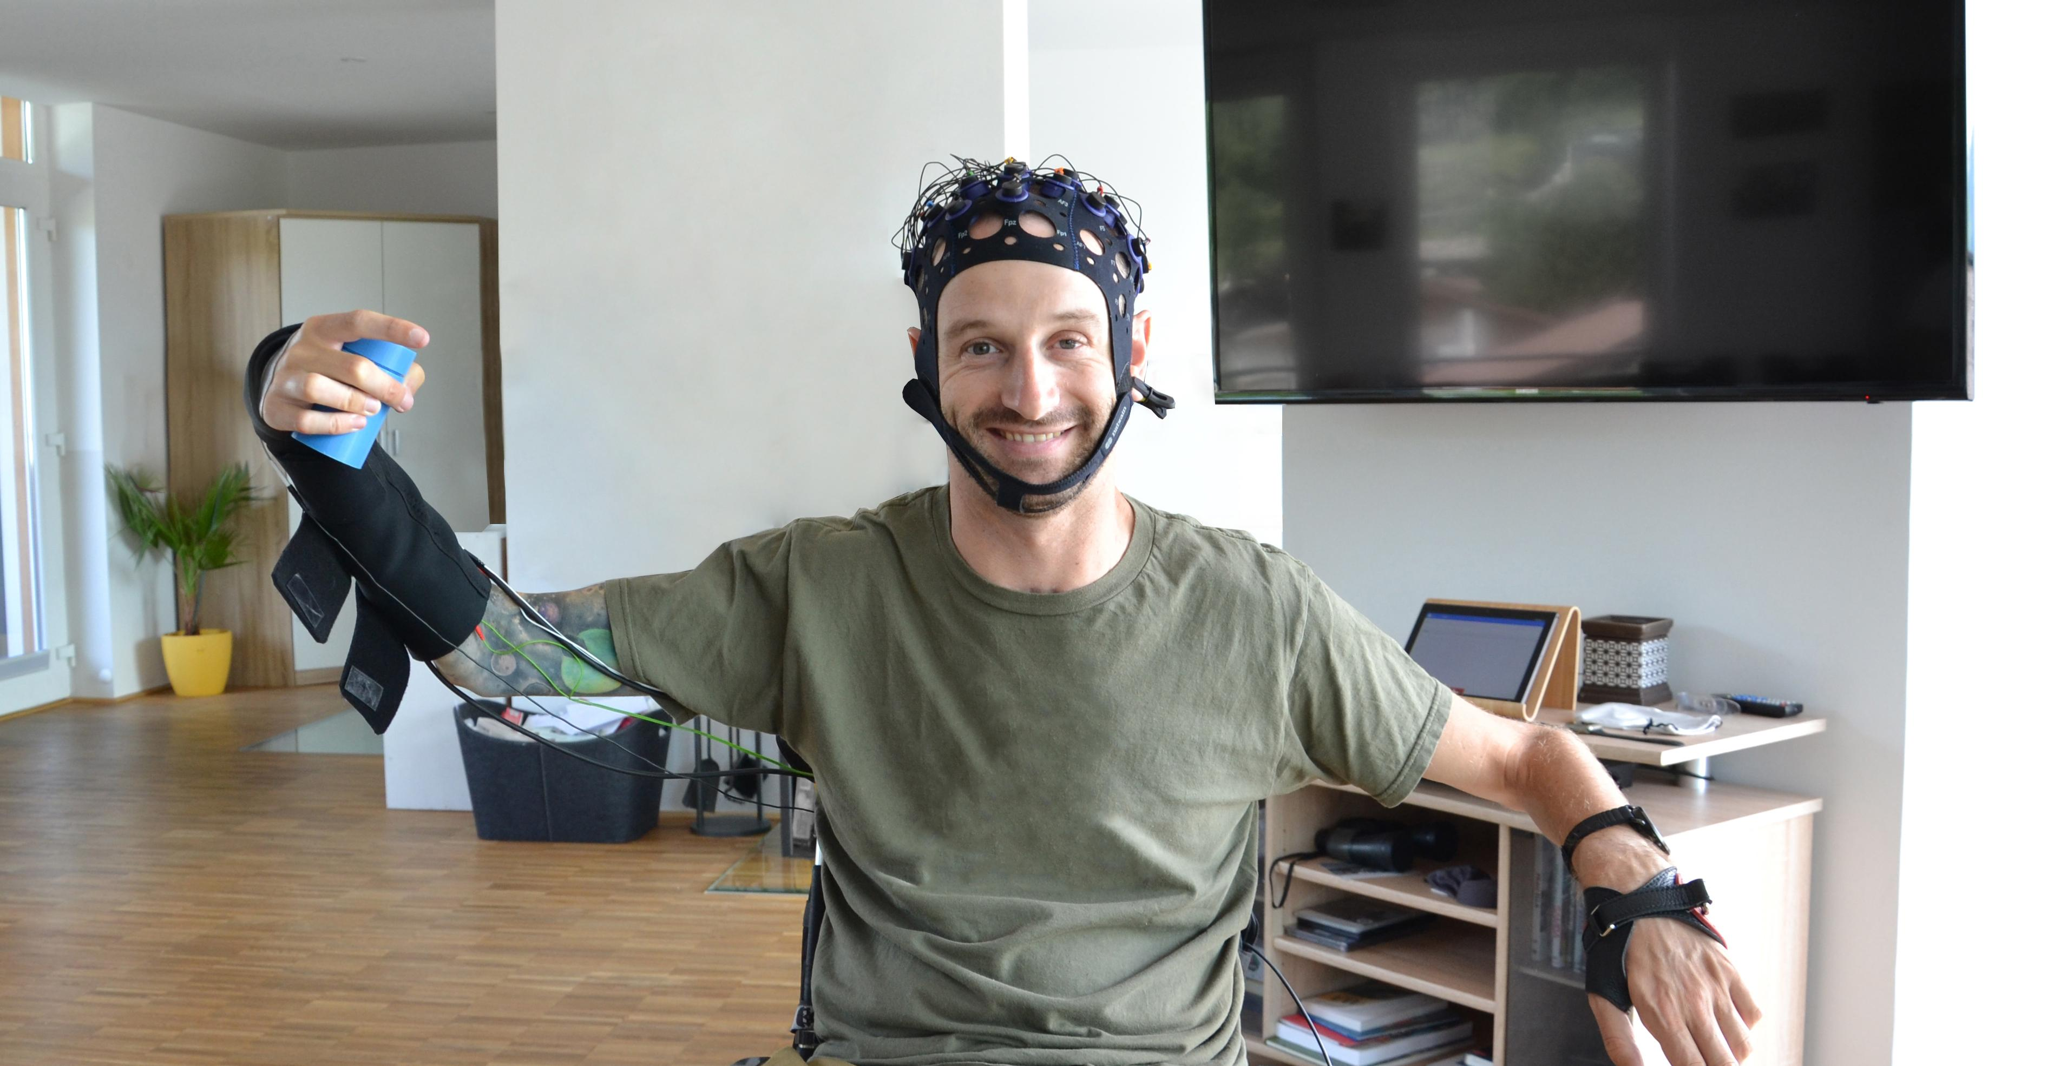
INtroduction: transfer learning

Slide 3
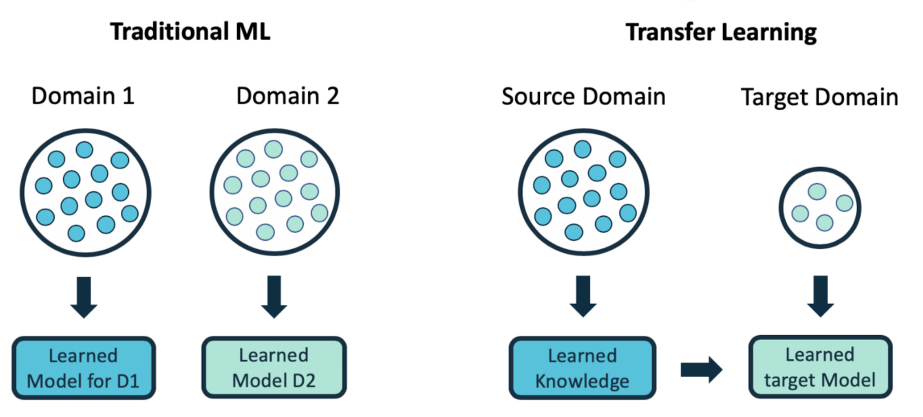
Introduction: transfer learning definition
Problem definition:
(domain and task)
Source and target domain
(brain signals of subjects)
Source and target task
(signal classification)
Knowledge transfer
(source to target)

Slide 4
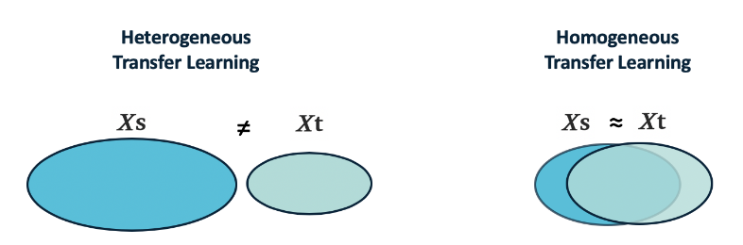
Introduction: transfer learning applications and settings
Advantages
Works with limited or no labeled target data
Efficiency through model reuse
Applicable to complex models with challenging computations and limited data (image recognition, NLP, speech recognition etc.)
Settings
Homogeneous transfer learning
Heterogeneous transfer learning
Inductive transfer learning
Transductive transfer learning
Unsupervised transfer learning

Slide 5
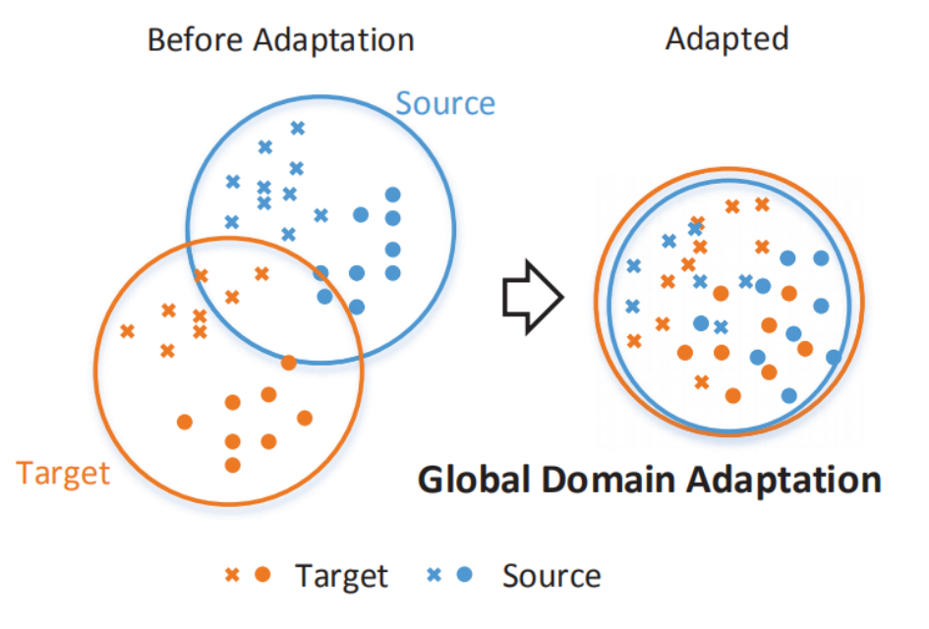
Introduction: transfer learning common approaches
Instance-based:
Source data are reused to maximize knowledge transfer
2SW-MDA (distribution weighting) and TrAdaBoost (iteratively reweights instances)
Feature-based
Domain-invariant features or feature transformations
Supervised (sparse feature learning, deep learning)
Unsupervised (space alignment, TCA)
Parameter-based
Reweighting source model parameters (Multi-Model Knowledge Transfer MMKT)

Slide 6
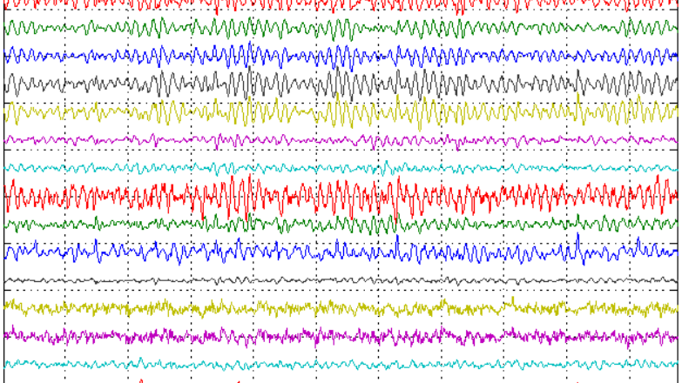
eeg signal classification using transfer learning

Slide 7
Eeg signal classification: the transfer learning approach
EEG signal variation (domain)
Lack of sufficient labeled data
Different subjects/sessions
Different devices
Different applications (task)
Different classifications
Cross subject/session
Cross device
Cross task

Slide 8
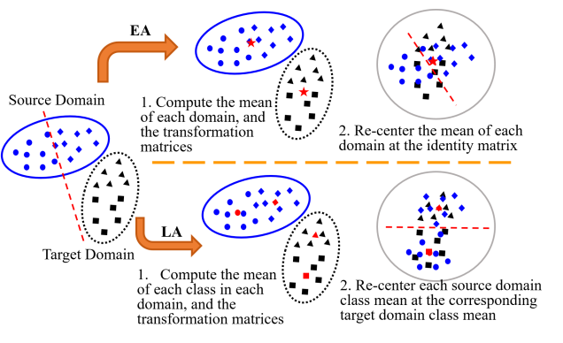
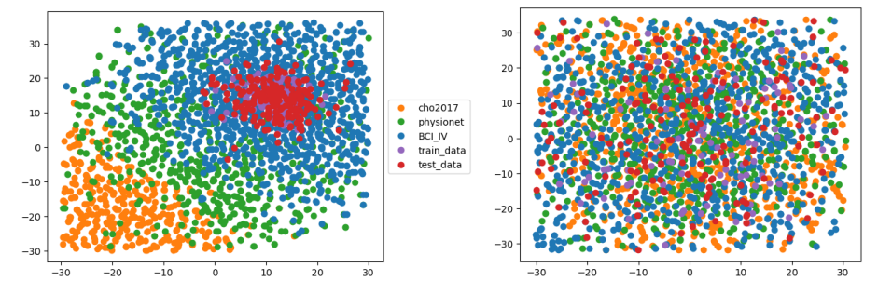
Eeg signal classification: transfer learning methods PART 1
Data alignment
EEG covariance matrices are SPD
RA (Riemannian Alignment)
Covariance matrices of resting trials as reference
Transformation to the reference
EA (Euclidean Alignment)
Makes the mean covariance matrix
for each trial to be the identity matrix
Feature extraction can be applied
LA (Label Alignment)
Mean covariance matrices for
each source and target are re-centered

Slide 9
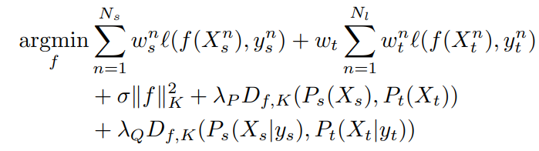
Eeg signal classification: transfer learning methods PART 2
Transferable features
CNN with three layers: feature extraction, feature reduction, dense layer trained on calibration data
Clustering training data and matching to the closest cluster
Subject Adaptation Network
Training a model for both source and target with regularization and different weights

Slide 10
Eeg signal classification: transfer learning methods PART 3
Other methods
Regularized Graph Networks
Features are learned so that domains can not be classified
Transfer Kernel method
Kernel matrices for the target are transformed to make their distribution similar to the source kernel matrix

Slide 11
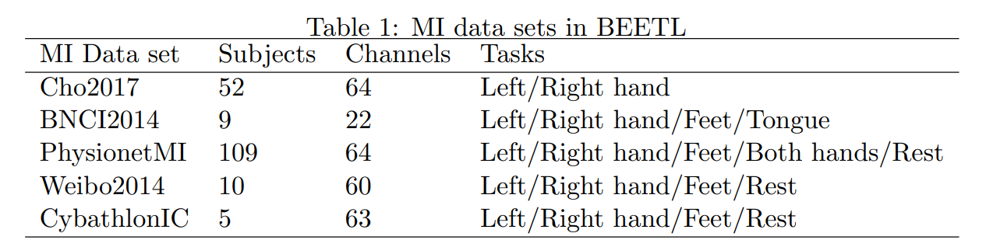
Nueroips Beetl 2021 competition
Automatic sleep stage annotation (6 classes)
40 users age 22-65 as training data
Transfer target is two different age groups (65-80 and 80+)
Each target age group has 5 subjects worth of data (limited labeled target data)
Physionet (Sleep-EDF). 197 Whole night sleep recordings
Motor imagery classification (3 classes)
Several motor imagery datasets with different setups (different channels and task definitions)
Limited labeled data for each target subject

Slide 12
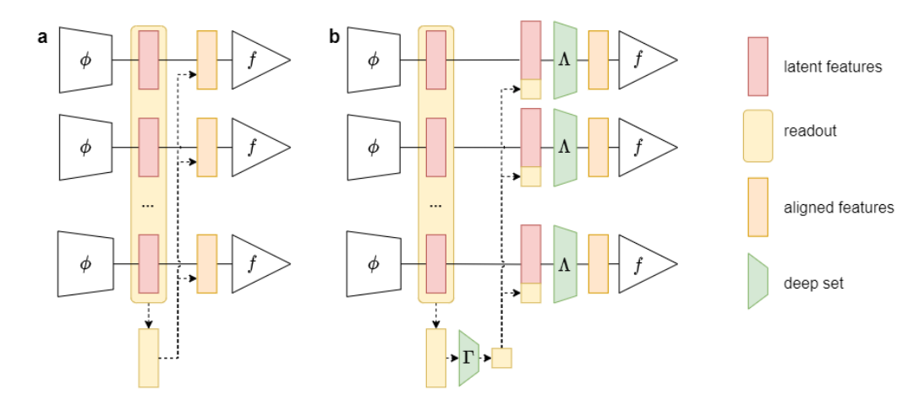
Neuroips Beetl 2021 competition: Winning teams
Baseline
Shallow ConvNet
57.6% and 49.9% score in tasks 1 and 2
Common channels of datasets
are used in task 2
Winning team: Team Cogitat
65.55% and 76.33% scores
Only the Physionet MI dataset with
the common channels
Latent feature alignment
Subject-wise batch normalization
Distribution embedding
Data alignment (Euclidean and Riemannian)

Slide 13
Challenges and other problems
Challenges
Feature selection
Transfer method
Computational complexity
Other problems
Transfer learning regression tasks
Heterogeneous TL (using EMG etc.)

Slide 14
references
Weiss, Karl, Taghi M. Khoshgoftaar, and DingDing Wang. “A Survey of Transfer Learning.” Journal of Big Data 3, no. 1 (2016). https://doi.org/10.1186/s40537-016-0043-6.
Pan, S. J., & Yang, Q. (2010). A Survey on Transfer Learning. IEEE Transactions on Knowledge and Data Engineering, 22(10), 1345–1359. doi:10.1109/tkde.2009.191
Wan, Zitong, Rui Yang, Mengjie Huang, Nianyin Zeng, and Xiaohui Liu. “A Review on Transfer Learning in EEG Signal Analysis.” Neurocomputing 421 (2021): 1–14. https://doi.org/10.1016/j.neucom.2020.09.017.
Wu, Dongrui, Yifan Xu, and Bao-Liang Lu. “Transfer Learning for EEG-Based Brain–Computer Interfaces: A Review of Progress Made since 2016.” IEEE Transactions on Cognitive and Developmental Systems 14, no. 1 (2022): 4–19. https://doi.org/10.1109/tcds.2020.3007453.
BEETL AI Challenge
P. Zanini, M. Congedo, C. Jutten, S. Said, and Y. Berthoumieu, “Transfer learning: a Riemannian geometry framework with applications to brain-computer interfaces,” IEEE Trans. on Biomedical Engineering, vol. 65, no. 5, pp. 1107–1116, 2018.
H. He and D. Wu, “Transfer learning for brain-computer interfaces: A Euclidean space data alignment approach,” IEEE Trans. on Biomedical Engineering, vol. 67, no. 2, pp. 399–410, 2020.
H. He and D. Wu, “Different set domain adaptation for brain-computer interfaces: A label alignment approach,” IEEE Trans. on Neural Systems and Rehabilitation Engineering, vol. 28, no. 5, pp. 1091–1108, 2020.
M. Long, J. Wang, J. Sun, and S. Y. Philip, “Domain invariant transfer kernel learning,” IEEE Trans. on Knowledge and Data Engineering, vol. 27, no. 6, pp. 1519–1532, 2015.
Bird, Jordan J.; Kobylarz, Jhonatan; Faria, Diego R.; Ekart, Aniko; Ribeiro, Eduardo P. (2020). "Cross-Domain MLP and CNN Transfer Learning for Biological Signal Processing: EEG and EMG". IEEE Access. Institute of Electrical and Electronics Engineers (IEEE). 8: 54789–54801. doi:10.1109/access.2020.2979074. ISSN 2169-3536

